Slide 1

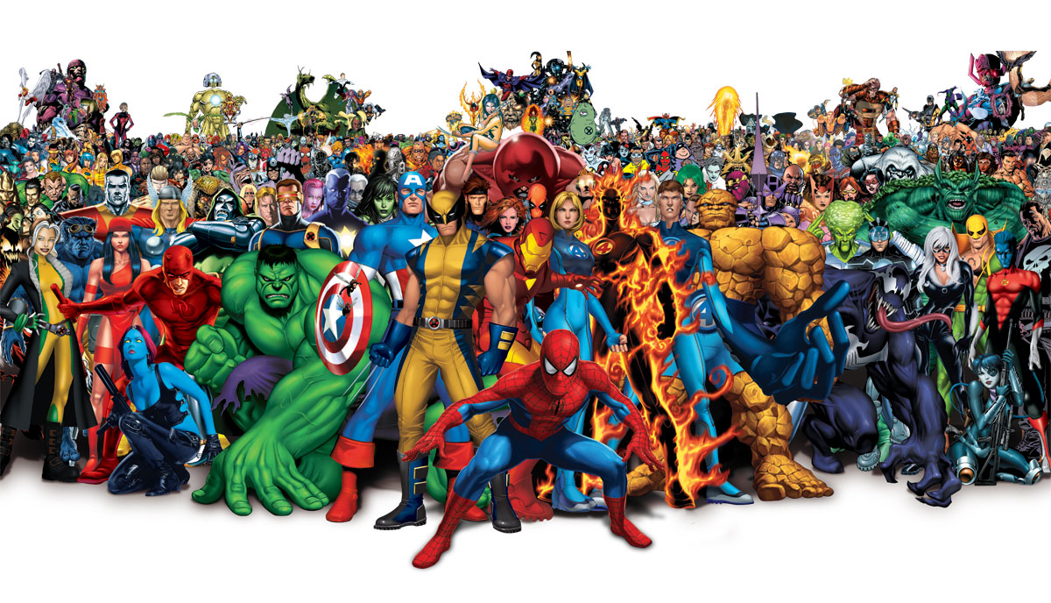
Are you related to a super hero?

Slide 2
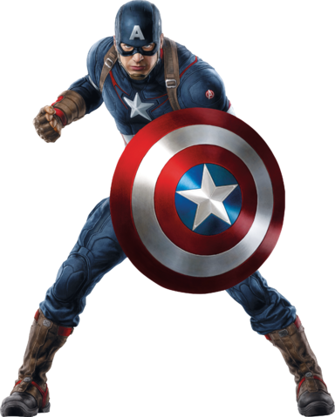
Application concept
Upload your photo to compare to an array of super hero photos. The application will return the match with the highest probability, along with a brief description of the hero. Searches are dated and stored and available for review.

Slide 3
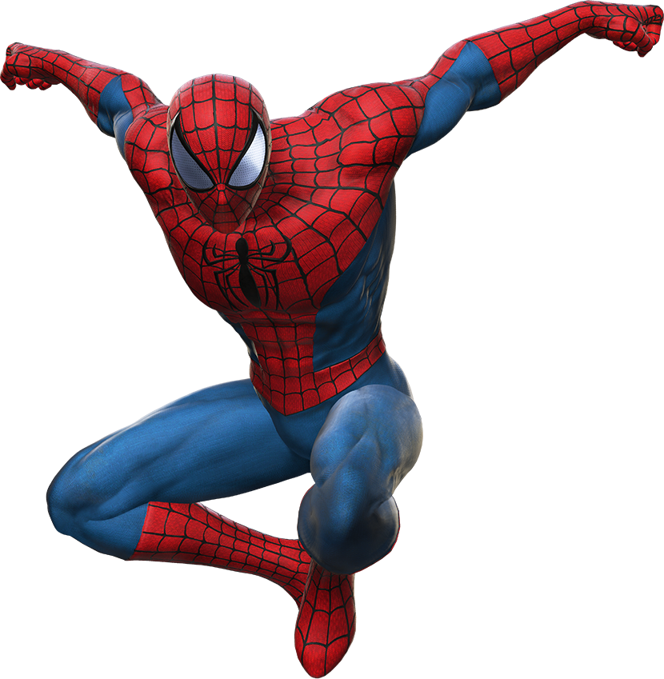
Why do this?
We wanted to find a fun way to interact with facial recognition software.

Slide 4
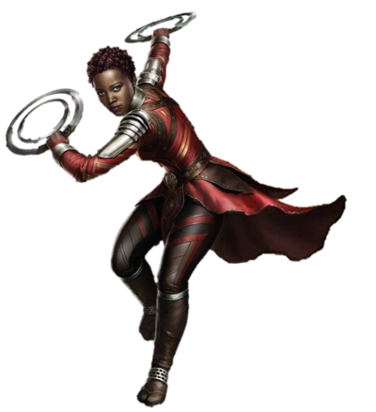
Design process
We started with a very high level concepts of different ideas, and worked through how we could make each idea work. After throwing out some ideas, we settled on an idea to pursue.
Each team member spent time researching various APIs to determine if this idea was feasible for this assignment, given the time constraints.
After determining to persevere, we developed what the minimal viable product would look like. We listed APIs we would use, thought of how we would utilize Firebase, what repeating element to use, etc.
We wrote user stories in GitHub, and created a project. Then each member assigned themselves some stories to work on. As we completed the stories, we closed and moved them to ‘Done’. We created additional user stories for gaps that were identified during the process.

Slide 5
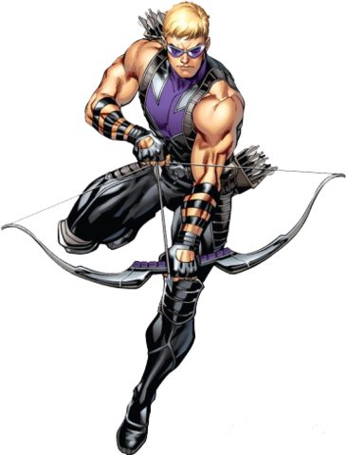
technologies
APIs: Face++, Marvel (via AJAX calls)
Database: Firebase
CSS Framework: Bootstrap
New Library:

Slide 6
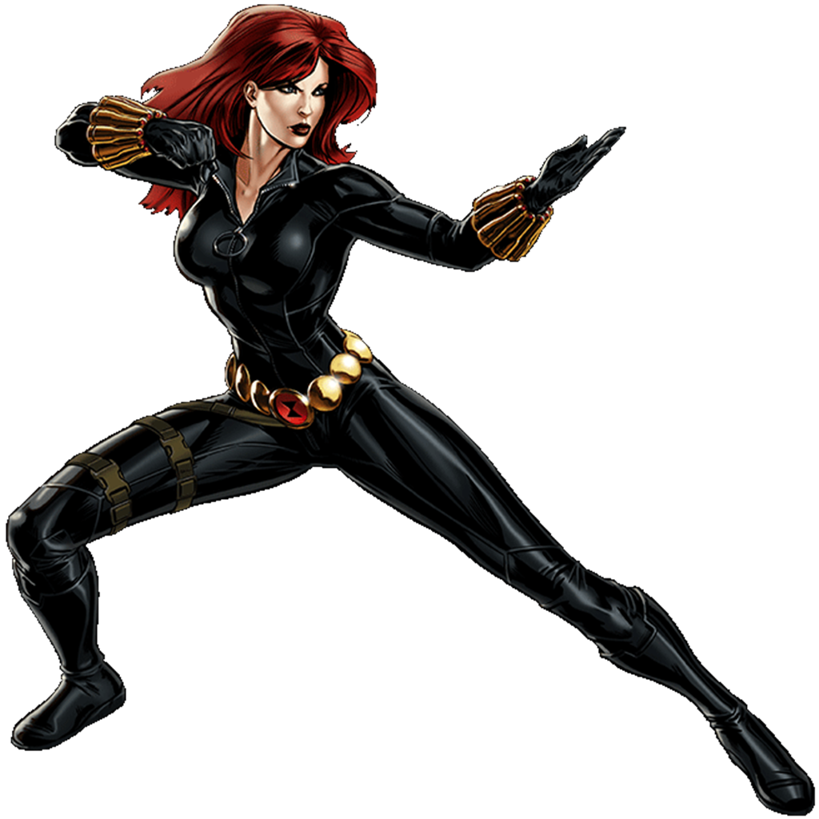
demonstration

Slide 7
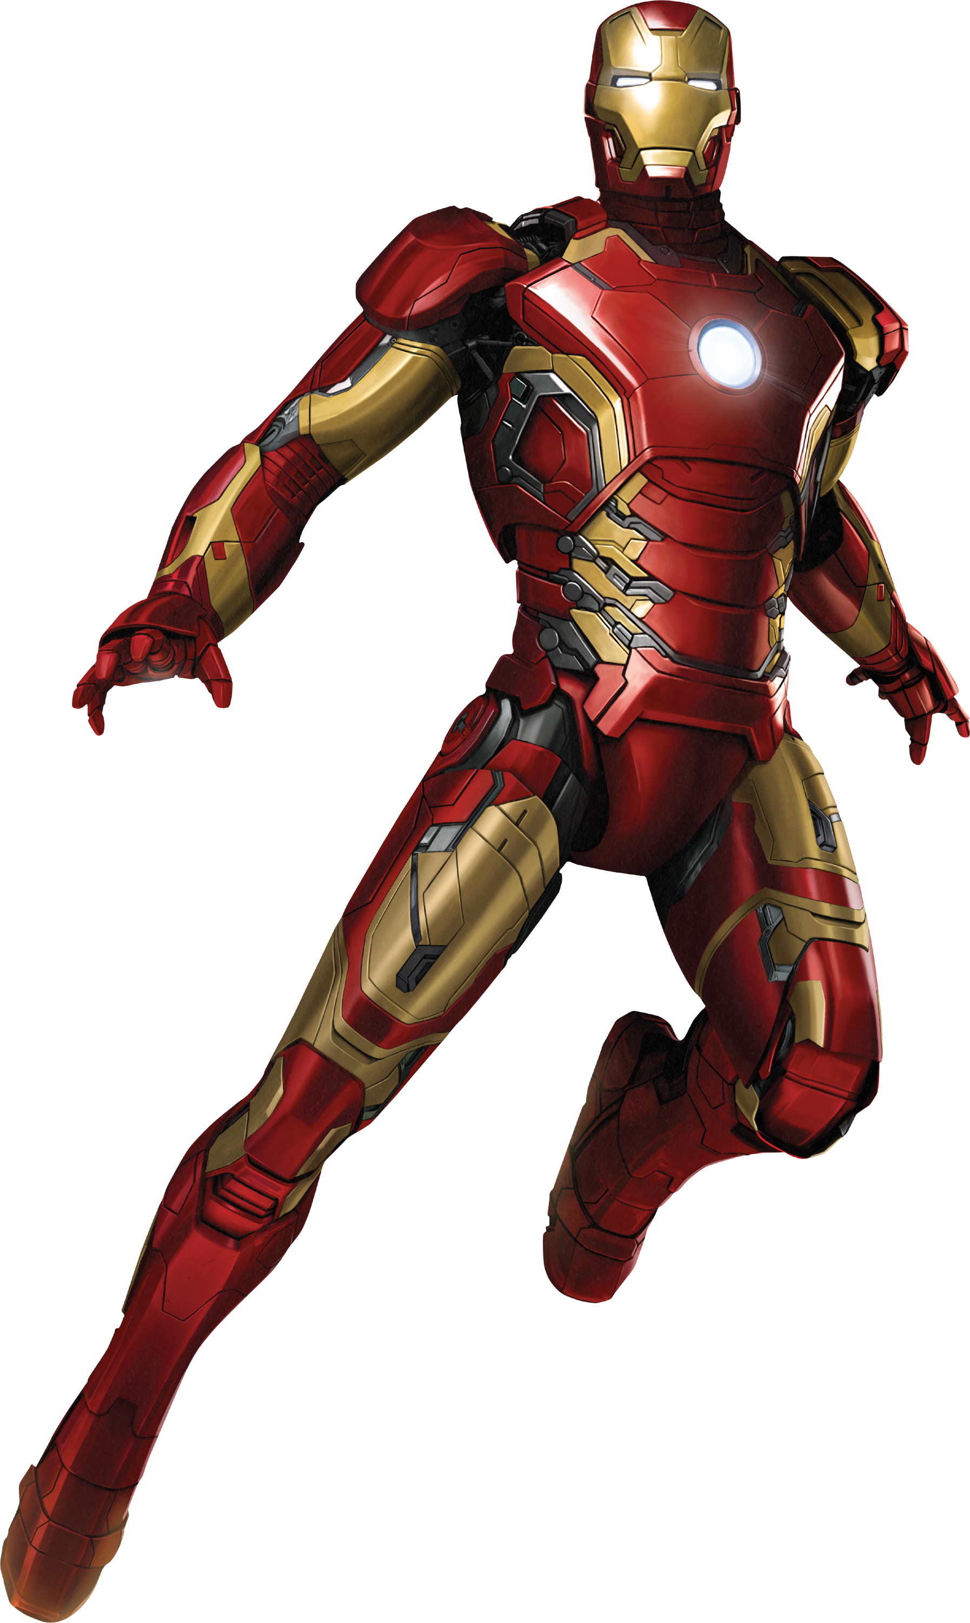
The future

Slide 8
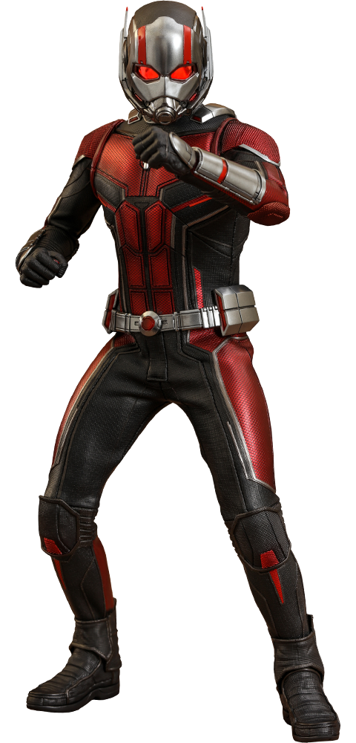
Questions

